Slide 1





Legal Innovation and Technology (LIT) Hackathon J.A.M. (Joint Analysis Methodology) System
Legal Innovation and Technology Team (LITT) Confidential
LITT

Slide 2
J.A.M. (Joint Analysis Methodology) System
Legal Innovation and Technology Team (LITT) Confidential
LITT

Slide 3

Legal Innovation and Technology Team (LITT) Confidential
LITT

Slide 4
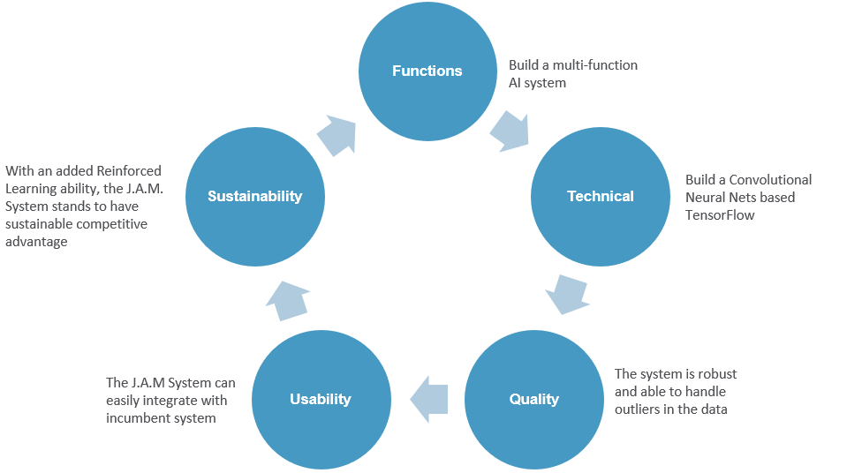


J.A.M. (Joint Analysis Methodology) System
Problem:
Lawyers face arduous and long research processes
Project Timeline
Problem Identification / Diagnosis Phase
Objective:
Leverage on data and Machine Learning for predictive analysis of case success probability
Enable lawyers to have quick access to the most relevant information in a simple and efficient manner
Problem Identification / Diagnosis Phase
1 Week
Current Status:
Phase 01: Problem Identification and Issue Diagnosis– Completed
Phase 02: Proof-of-Concept– In Progress
Phase 03: Additional Data Synthesis– Pending
Proof-of-Concept (POC)
Internal Operations Optimization
1 Week
Fabrication
Additional Data Synthesis
3 Weeks
Design Concept
Major Deliverables
Problem Statement 2 [POC]
A Machine Learning (ML) model that assists lawyers in searching for the most relevant cases while on-the-go (with potential for reinforcement learning)
Problem Statement 8 [MVP]
A ML algorithm that leverages on text-mining and data analytics to analogise cases to predict cases success probability
Problem Statement 3 [POC]
Is addressed when solving Problem Statement 2 & 8
Model Implementation
& Training
9 Weeks
Minimum Viable Product
(MVP)
End Apr 2019
Legal Innovation and Technology Team (LITT) Confidential
LITT
Empyrium Consulting Confidential

Slide 5
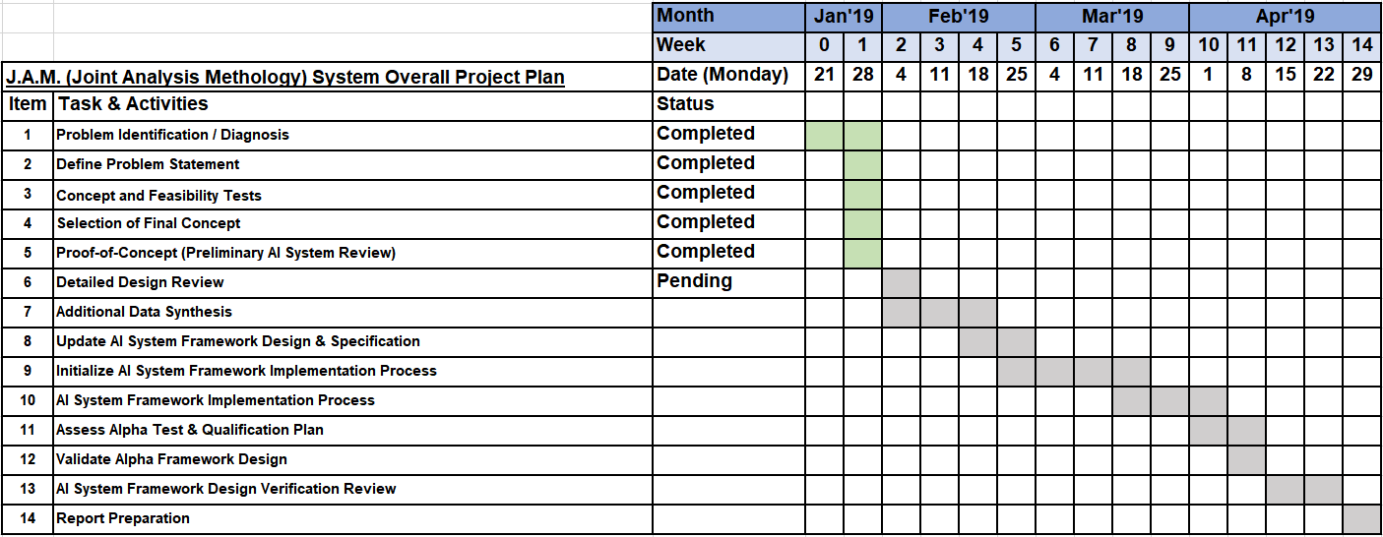
Gantt Chart
Legal Innovation and Technology Team (LITT) Confidential
LITT

Slide 6
Legal Innovation and Technology Team (LITT) Confidential
LITT

Slide 7
Legal Innovation and Technology Team (LITT) Confidential
LITT

Slide 8
J.A.M. (Joint Analysis Methodology) System
End
Legal Innovation and Technology Team (LITT) Confidential
LITT

Slide 9
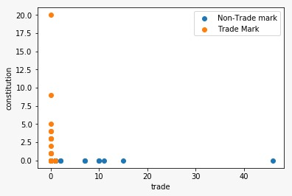
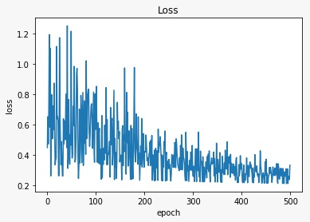
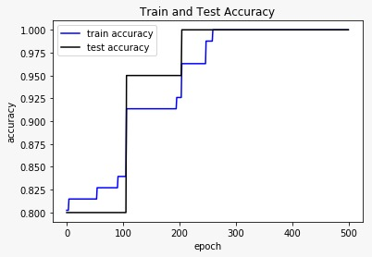
Case Classifier (SVM)
Legal Innovation and Technology Team (LITT) Confidential
LITT

Slide 10
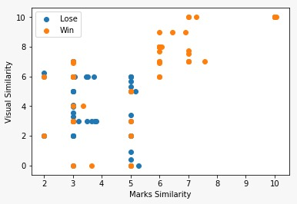
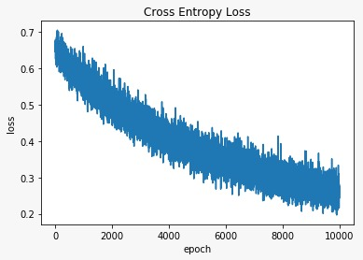
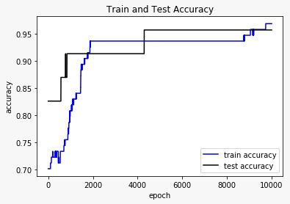
Win-rate Prediction (Logistic Regression)
Legal Innovation and Technology Team (LITT) Confidential
LITT

